Slide 1


CS/ECE/EEE/INSTR F215:Digital Design
Lecture 24: Analysis of clocked sequential circuits
Sat, 30 Oct 2021
Dr. R. N. Ponnalagu, EEE

Slide 2
Strength and Growth
come only through
continuous effort
and struggle
– Napoleon Hill

Slide 3


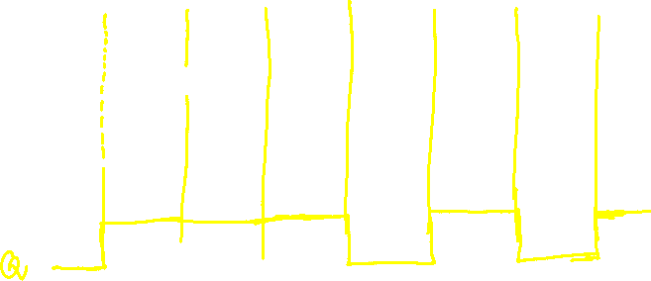


Slide 4
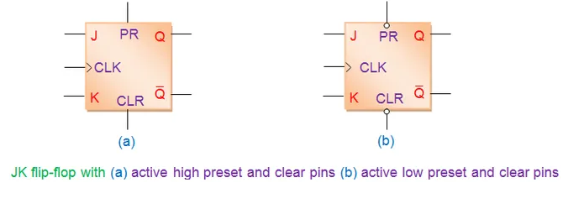
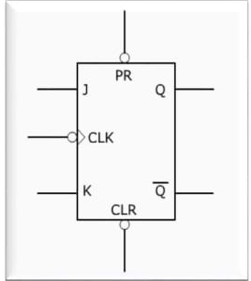
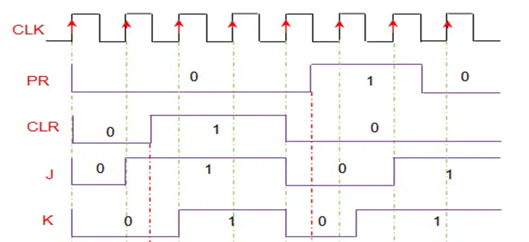
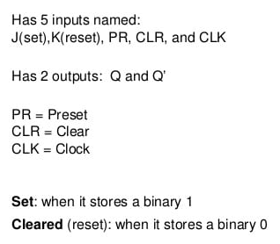


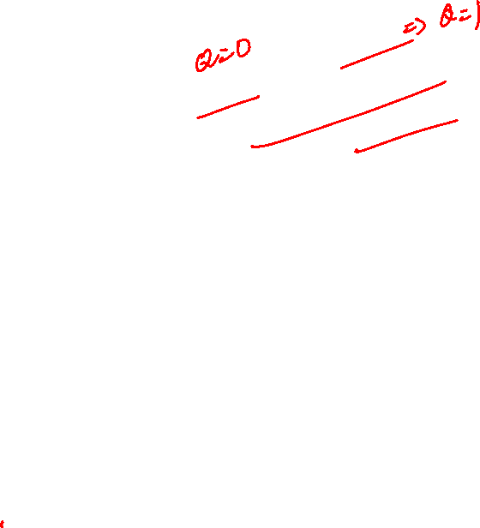


Slide 5
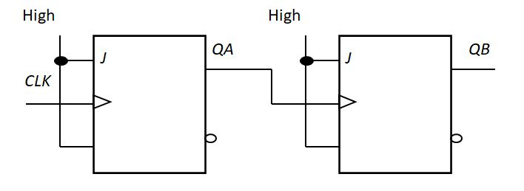

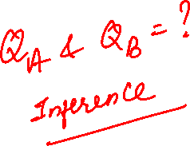

Slide 6


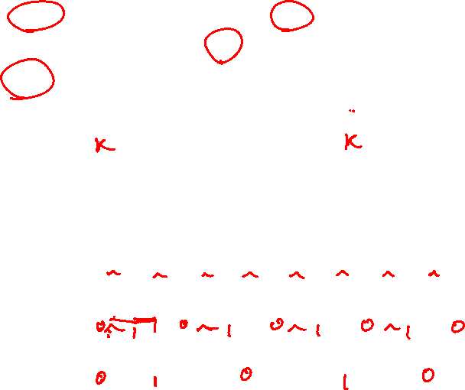

Slide 7
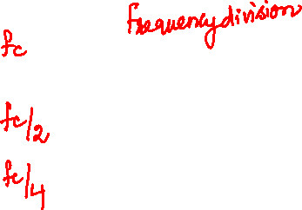
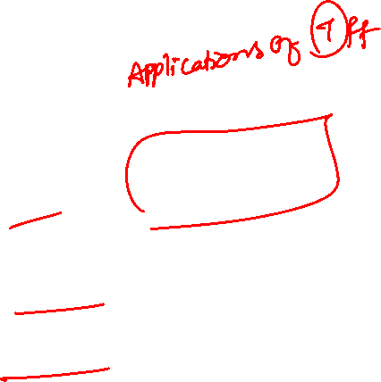
High
High
J
QA
J
QB
CLK
K
K
CLK
QA
QB

Slide 8
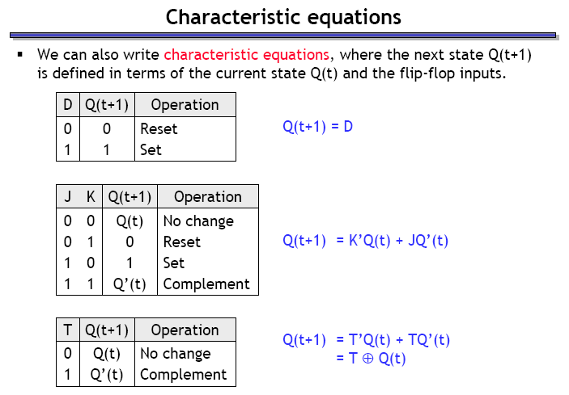
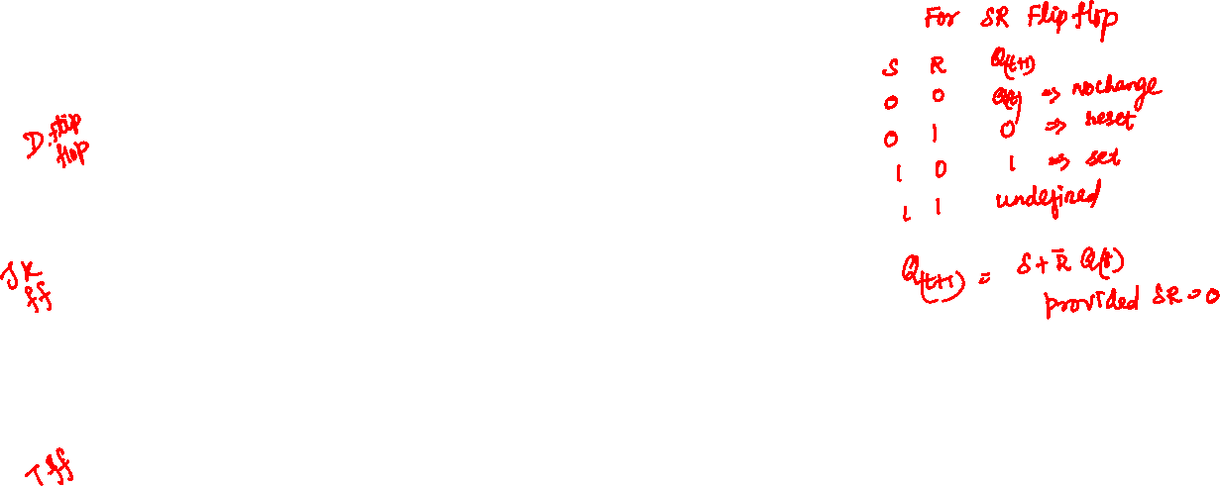
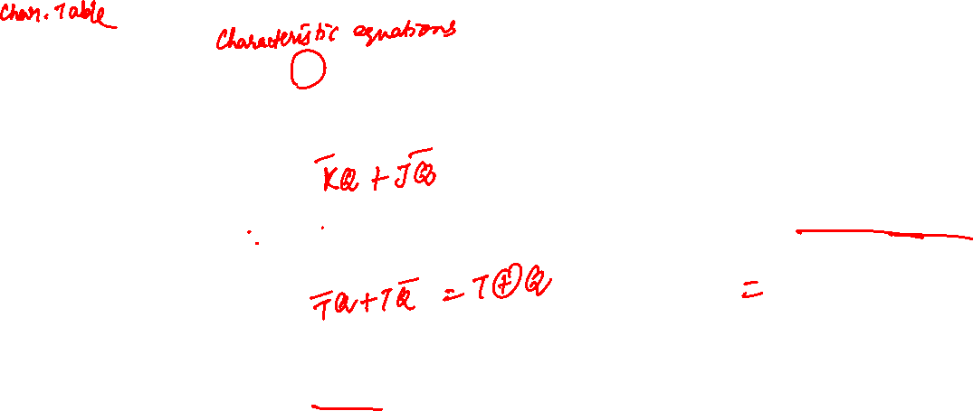
T
J
K
Q
Q'
CLK

Slide 9
ANALYSIS
OF
SEQUENTIAL CIRCUITS

Slide 10

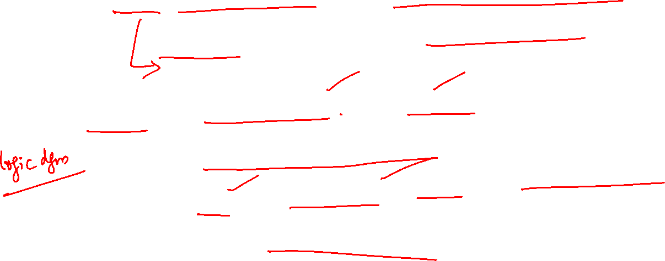
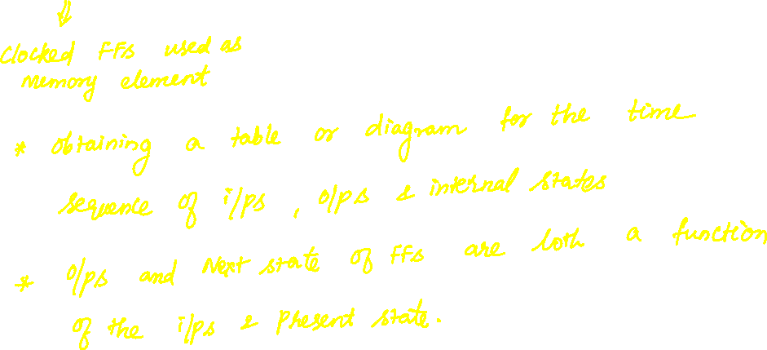

Slide 11
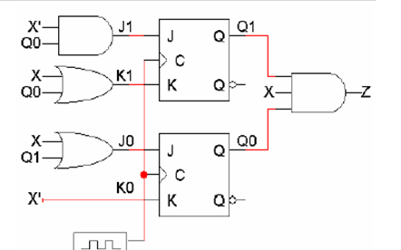
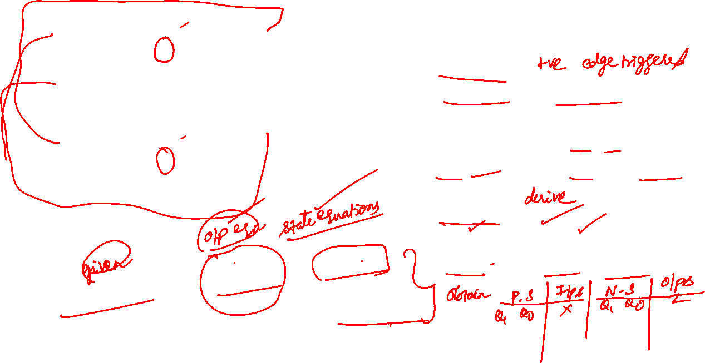

Sequential Circuit with
2 JK FFs;
input X and output Z
Flip flop inputs J1, K1 and J0, K0, outputs Q1 and Q0
State table:
Inputs, Flip flop states
(current and next), outputs

Slide 12
Making a State Table

Slide 13
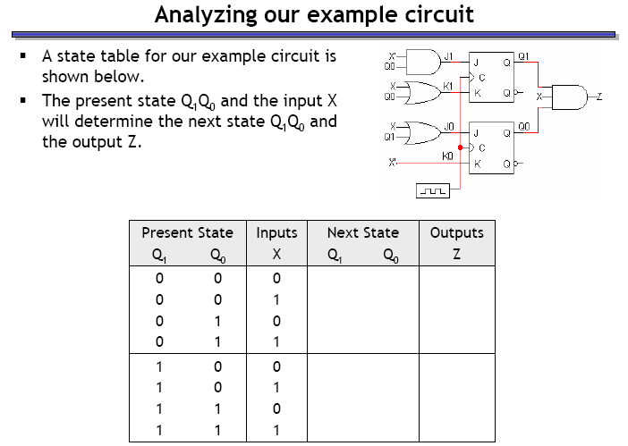
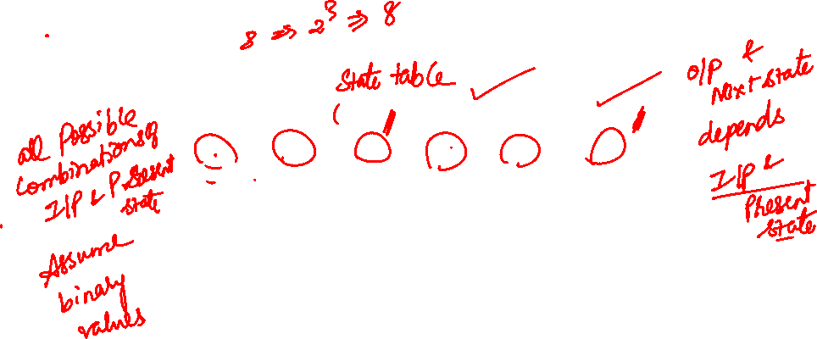

Slide 14
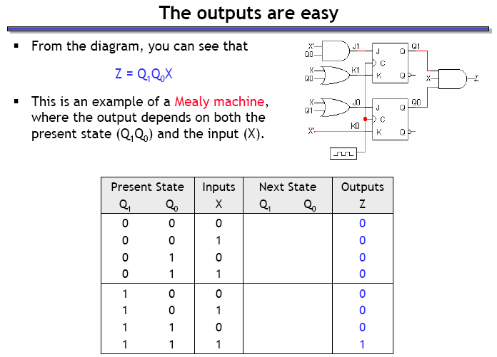
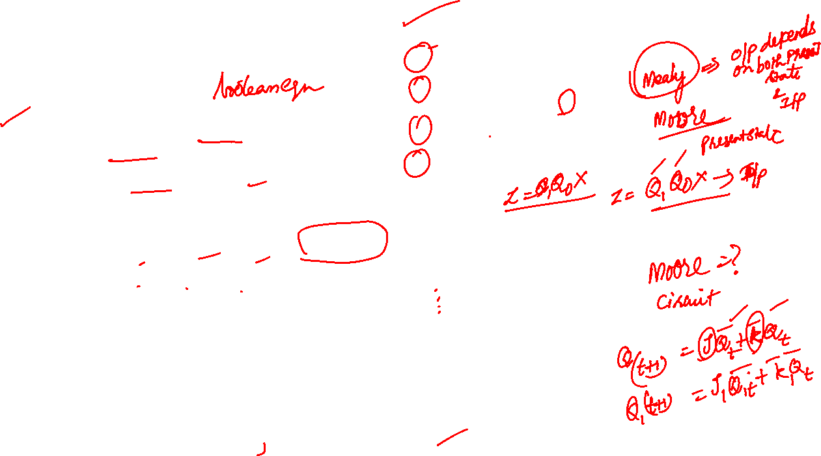

Slide 15
Finding the Next State of the circuit
Find the Boolean Equations for the flip flop inputs in terms of present state and ext. inputs
Using the equations find the actual values of flip-flop inputs for each possible combinations of present states and inputs
Use Characteristic tables/equations to find the next state based on flip-flop input values and the present state

Slide 16

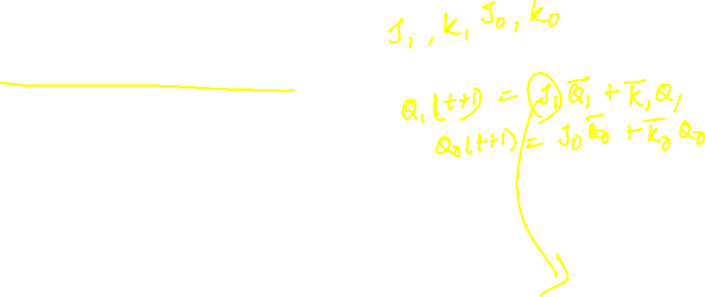
Find the Boolean Equations for the flip flop inputs in terms of present state and ext. inputs
Derive state equations from flip flop input equation and characteristic equation of flip flops
Derive the next state values from state equations by substituting binary values of all combinations of present state and input(s).

Slide 17
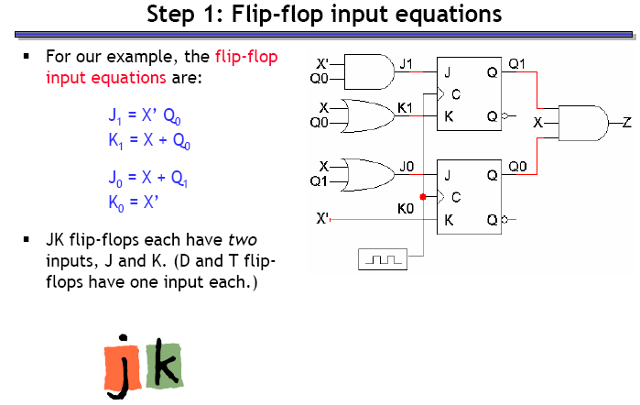


Slide 18
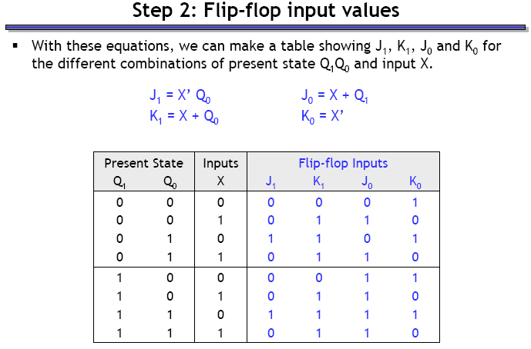


Slide 19
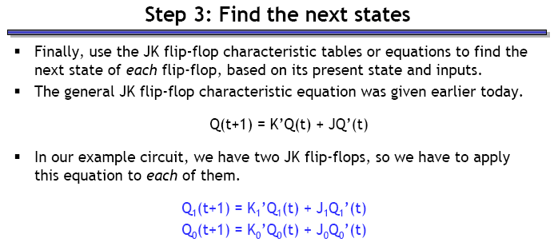

Slide 20
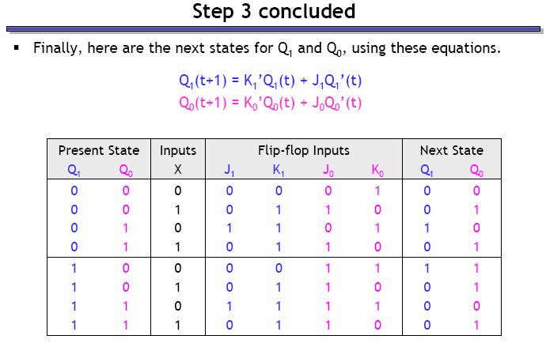


Slide 21
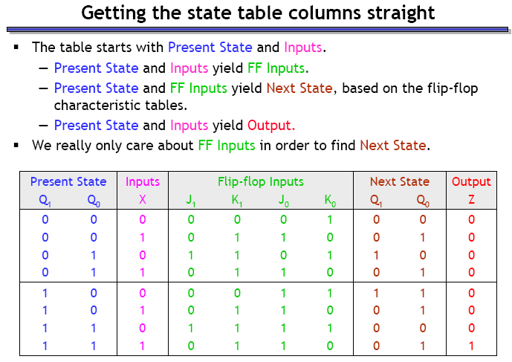
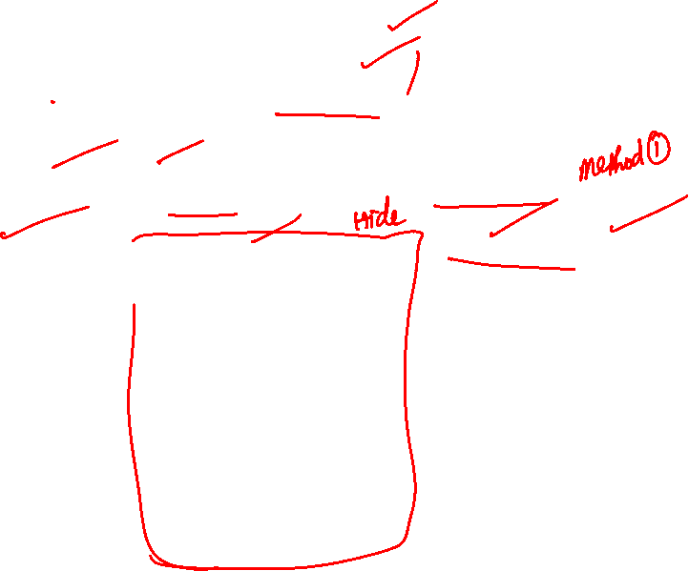

Slide 22
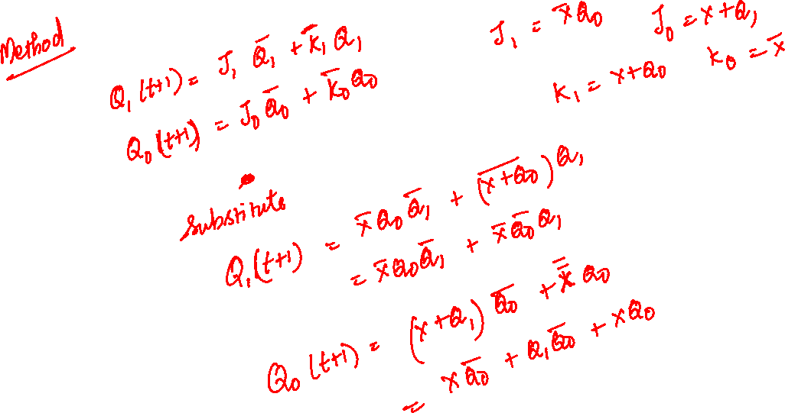
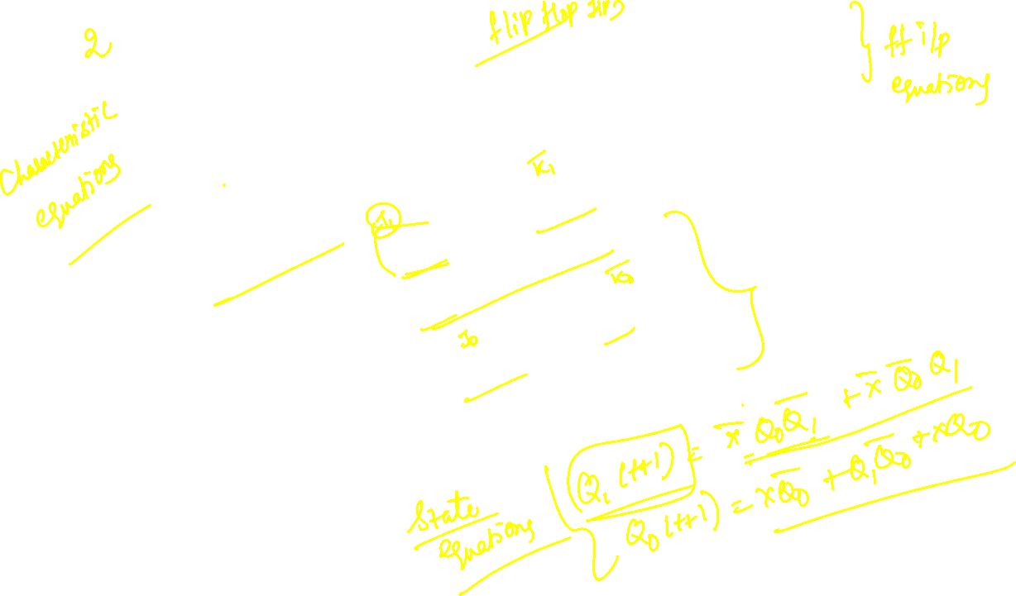

Slide 23
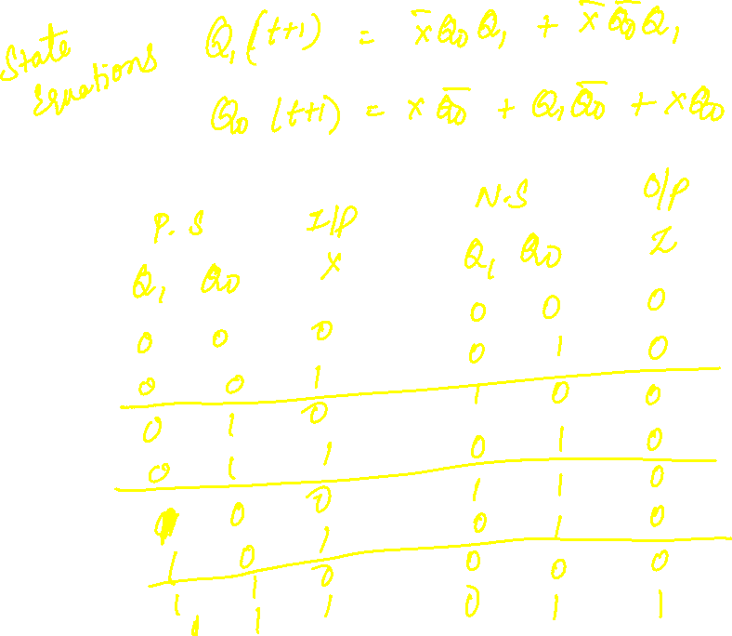
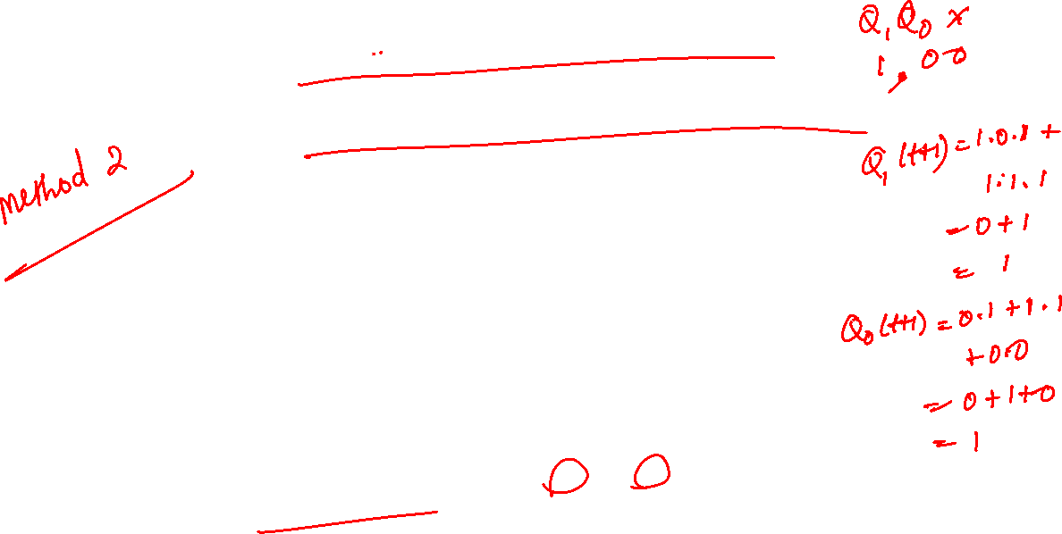

Slide 24
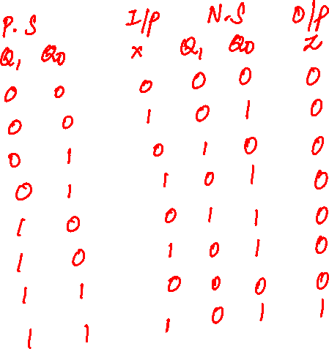
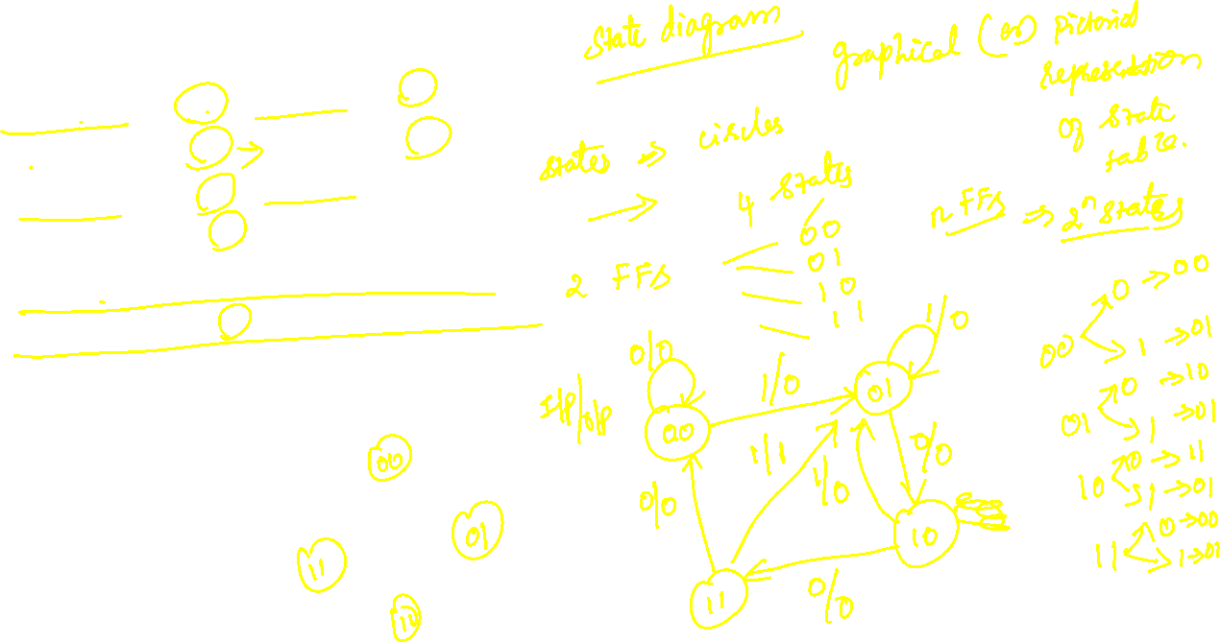

Slide 25
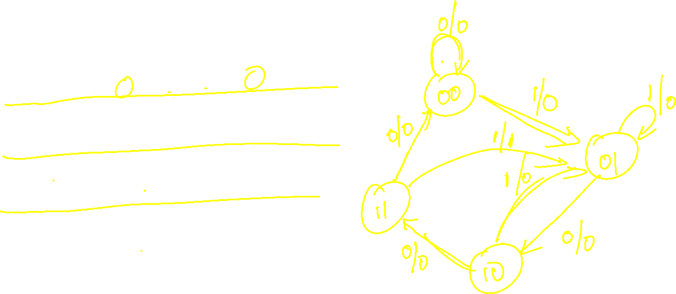

Slide 26
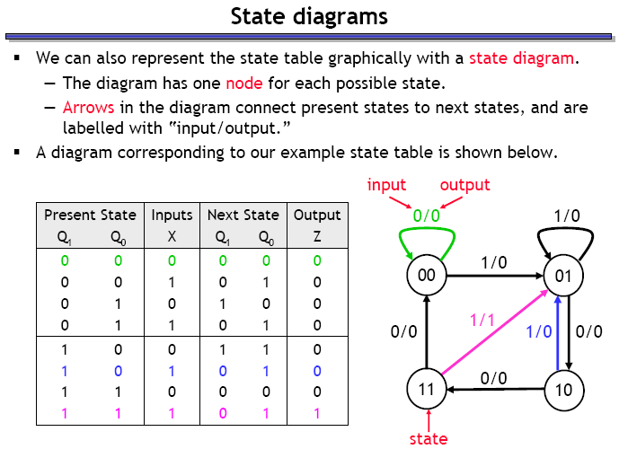


Slide 27
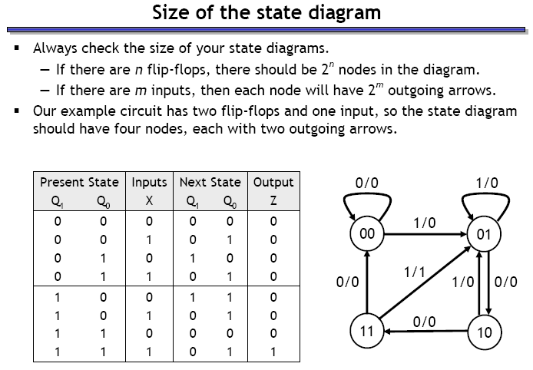
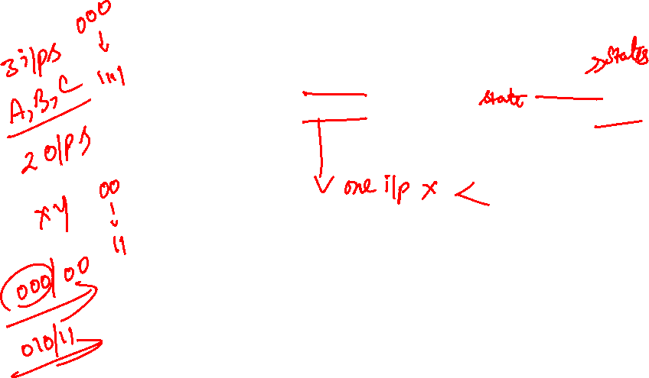

Slide 28
